Slide 1
Decision Making and Problem Solving
Session 3 Decision Making
using the
Logical Approach
Andre Samuel
http://www.samuellearning.org

Slide 2
Last Session
How decisions are Made?
Types of Problems
Logical Decision Making Process
Newell and Simon (1972)- 3 stages
Simon (1977)- 4 stages
Adair (1997)- The classic approach

Slide 3
ASK SIR L
Simon’s Model
A appreciate
S specify
K causes
S solutions
Generate
Select
I implement
R review
L earn
Intelligence stage
Design stage
Choice stage
Implement stage

Slide 4
This Session
Decision Making- Selection of Solution
Techniques for Generating Options
Techniques for Evaluating Options

Slide 5
Solution Stage of Problem Solving Process
This involves using the knowledge from the fact finding or intelligence stage, where the goals and problem are properly defined.
It involves considering options or strategies that might be implemented
Decision Making is the act of making that choice, deciding which option will be implemented

Slide 6
Process:
This is the stage where the problem solver has to:
Generate Ideas- search for potential solutions
2. Select- make a choice from the potential solutions

Slide 7
Idea Generation- options
Options rather than alternatives
An alternative is literally one of two courses open.
Decision-makers who lack skill tend to jump far too quickly to the either–or alternatives.
They do not give enough time and mental energy to generating at least three or four possibilities.
‘You can be sure that if the enemy has only two courses of action open to him, he will choose the third.’
Alfred Sloan, the renowned President of General Motors, was even known to adjourn meetings in which he was presented with two alternatives. ‘Please go away and generate more options,’

Slide 8
Idea Generation
Creativity is needed to generate ideas
Guilford (1967) claimed that Divergent Thinking is related to creativity
Divergent thinking involves a broad search for options, finding many combinations of elements
Weisberg (1986) argues that novel solutions can be achieved without Divergent Thinking
Convergent Thinking involves searching for a unique solution to meet a prescribed criteria and therefore applies a greater degree of judgment and narrow focus
Guilford (1975) suggest that these two modes are not necessarily in isolation and can be intermixed
A divergent approach can be used on the way to a convergent solution

Slide 9
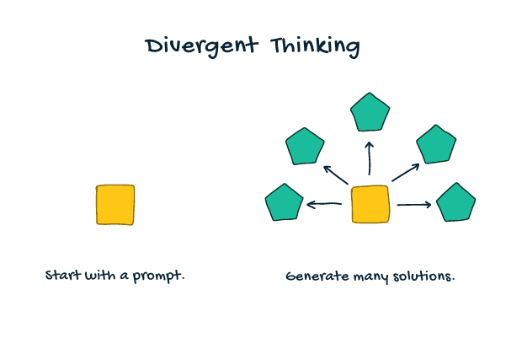
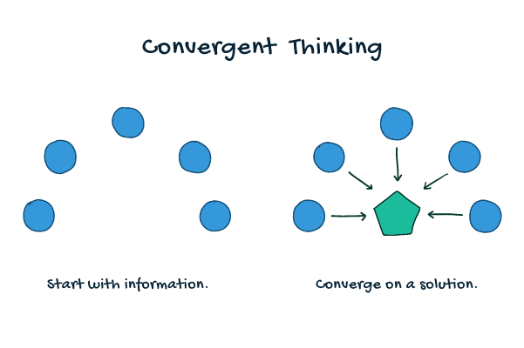
Divergent vs Convergent Thinking

Slide 10
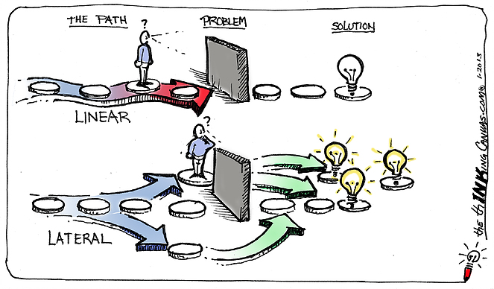
Idea Generation
Six Hats:
White - Objective
Red - Emotional
Yellow - Optimistic
Black - Critical
Green - Creative
Blue – Control and Overview
Lateral Thinking coined by Edward De Bono, involved opening oneself to creative thinking
It requires different perspectives to be taken into consideration
It requires people to look at things in an unconventional manner
Essentially, it involves viewing problems from a new perspective in order to create innovative solutions and move away from conventional ideas
De Bono (1985) suggest the Six Thinking Hats method

Slide 11
De Bono states:
“vertical thinking digs the same hole deeper; lateral thinking is concerned with digging a hole in another place”
Cited in Dacey (1989)
Po- Provocative Operation- introducing a new patterning system through discontinuity
Use Movement Value rather than Judgement

Slide 12
Idea Generation
Emergent Strategy put forward by Kanter (1983) promoted the Improvisational model
Strategic options are created by exploring new possibilities
Even in anticipated situations where you can set standard procedures for dealing with it, unanticipated situations may arise, which require immediate attention
Emergent thinking leads to improvisation, which involves generating new insights very rapidly

Slide 13
Idea Generation creative people in history have been credited as being ‘whole-brain thinkers’- harness the strengths of both left- and right-brain thinking
The Left Hemisphere: Logical and Critical Thinking
The Right Hemisphere: ‘Blue Sky Thinking
Our left hemisphere is dominant when we are using logic – for example, making a list, following a step-by-step process, proof-reading a document or working out simple algebra.
Critical Thinking- this involves questioning assertions, trying to find the flaws in a position, and testing an argument in as harsh a manner as possible.
Our right hemisphere is predominant for many creative activities, including any performance arts, using the imagination, daydreaming and recognising colours
‘Blue Sky Thinking’ – this means generating many ideas without any barriers, doubts or objections

Slide 14
Techniques for Idea Generation
Use Strategy Toolkit
SWOT and the TOWS Matrix
Porter’s value chains, added value
Product portfolio / range / loss leaders- BCG Matrix
Product life cycle
Porter’s 5 Forces: existing competitors, suppliers, buyers, new entrants, substitute products
Porter’s generic strategies: cost lead, differentiate, focus
Ansoff matrix: new / old products; new / old markets
Marketing mix: product, place, price, promotion

Slide 15
Misc Idea Generation Techniques
Brainstorming
Synectics
Suggestion Box, Exhibits and Competitions
Storyboarding
Mind Map
Fishbone
Lotus Bloom

Slide 16
Selection- Choice
This stage requires all the options to judged
This looks at decision making
Deciding whether or not it is worthwhile taking any ideas that have been generate any further
In other words, Validation of the options are undertaken
It involves:
Sorting or Shortlisting
Evaluation methods or techniques

Slide 17
Process of Sorting and Evaluation Proctor (2014)

Slide 18
Short listing
Strategic Choice:
Suitable
Acceptable
Feasible
Establish vital requirements
Compare feasible solutions to requirements
Adapt solutions to improve match
Discard any:
- not meeting all vital requirements
- clearly inferior to another solution

Slide 19
Adair (1997) Lobster Pot Model

Slide 20
Adair (1997) Decision Making Criteria

Slide 21
Establishing a Criteria

Slide 22
Evaluating Country Risk for International Investing
The decision to invest overseas should begin with determining the riskiness of the investment climate in the country under consideration.
Country risk refers to the:
economic,
political and
business risks
that are unique to a specific country, and that might result in unexpected investment losses.

Slide 23
Type of Markets of International Investing
Developed Markets- economic systems are well developed
United States, Canada, France, Japan, and Australia.
Emerging Markets- high levels of economic growth
BRIC (Brazil, Russia, India, China)
Other emerging markets are Mexico, Indonesia, South Korea, Turkey, Colombia, Indonesia, Vietnam, Egypt, Turkey, and South Africa
Frontier Markets-"the next wave" of investment destinations
Nigeria, Botswana, and Kuwait.
Argentina, Chile, Mexico, Peru, and Turkey

Slide 24
Measuring Country Risk
Credit Rating- Moody’s, S&P
GDP, Inflation, Consumer Price Index, Fx
Performance of local stock market
Sources of Info on Country Risk:
The New York Times, The Wall Street Journal and the Financial Times
The Central Intelligence Agency's (CIA) "The World Factbook"

Slide 25
Evaluation Techniques
Advantage-Disadvantage Table
PMI: Plus/Minus/Interesting
Force Field Analysis
Weighted Analysis
Financial Analysis

Slide 26
Advantage-Disadvantage Table

Slide 27
PMI: Plus/Minus/Interesting

Slide 28
Force Field Analysis

Slide 29
Weighted Analysis
Establish desirable criteria
Weight for importance
Score each solution against each criterion
Multiply by weighting
Add results to get weighted scores
Highest total wins

Slide 30
Financial Analysis techniques
Cost-benefit analysis
Discounted cash flow
Net present value
Expected Pay off= Expected Cost-Expected Benefit
Decision ‘rules’: Maximin, maximax, minimax regret
Decision trees
‘What if’ analysis

Slide 31
Cost Benefit Analysis
See template at
www.samuellearning.org

Slide 32
Net Present Value
Think of a project as an abandoned suitcase containing money.
If the amount of cash is positive you will pick it up
If the suitcase contains ‘negative cash’ which would diminish your wealth you will leave it alone
NPV simply states how much money is in the suitcase and whether it is positive or negative

Slide 33
NPV technique involves estimating the cash flows associated with an investment, discounting those cash flows received or paid in the future and deducting the cost of the initial investment

Slide 34
Present Value Table

Slide 35
Discounted Cash Flows and Net Present Value

Slide 36
Pay off Tables

Slide 37
Decision ‘rules’
Maximax – Maximizes the maximum payoff ( Best of the Best)
Maximin- Maximizes the minimum payoff (Best of the Worst)
minimax regret- Minimizes the maximum regret (Best of the Regrets) bearing in mind regret= best payoff- actual payoff

Slide 38
Decision Trees
Method of prioritizing projects which require a series of decisions
Provide structured view of different project options and investigate possible outcomes of choosing each option
They take into account estimated risks and rewards associated with each possible course of action

Slide 39
Decision Trees

Slide 40
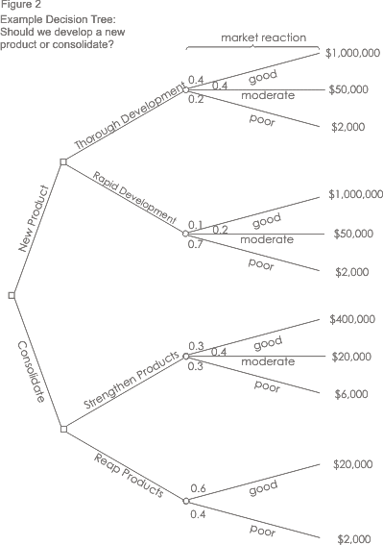

Slide 41
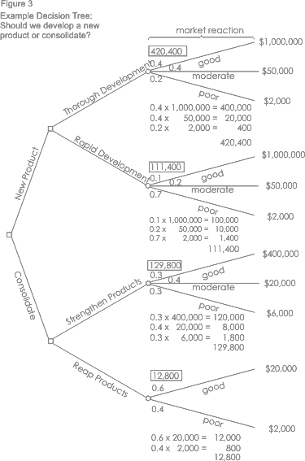

Slide 42
